Slide 1


Advertising Website “Barquillos Choc”
Developed by:

Slide 2
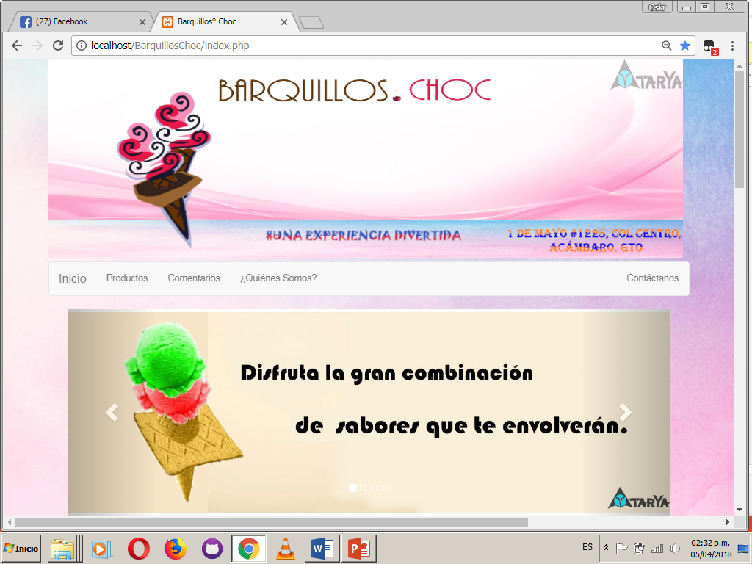
WEB SITE

Slide 3
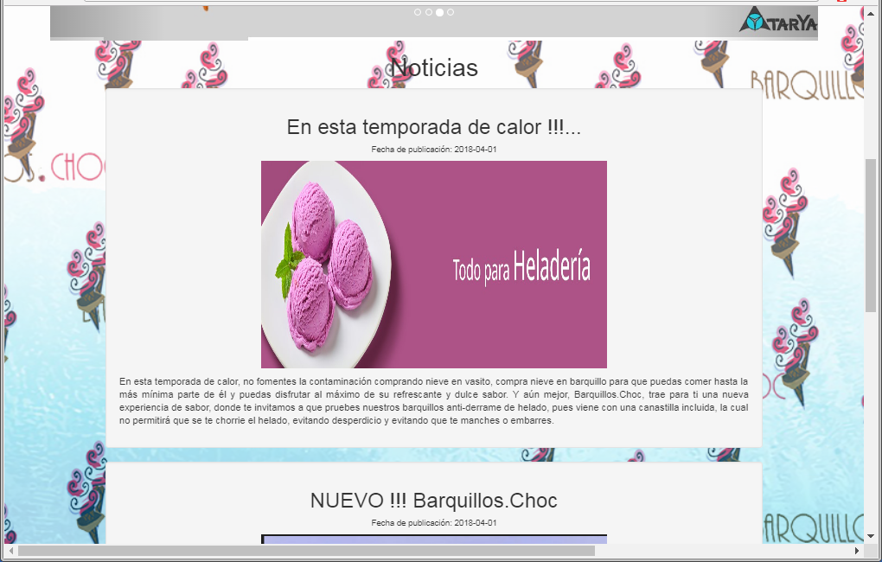
WEB SITE

Slide 4
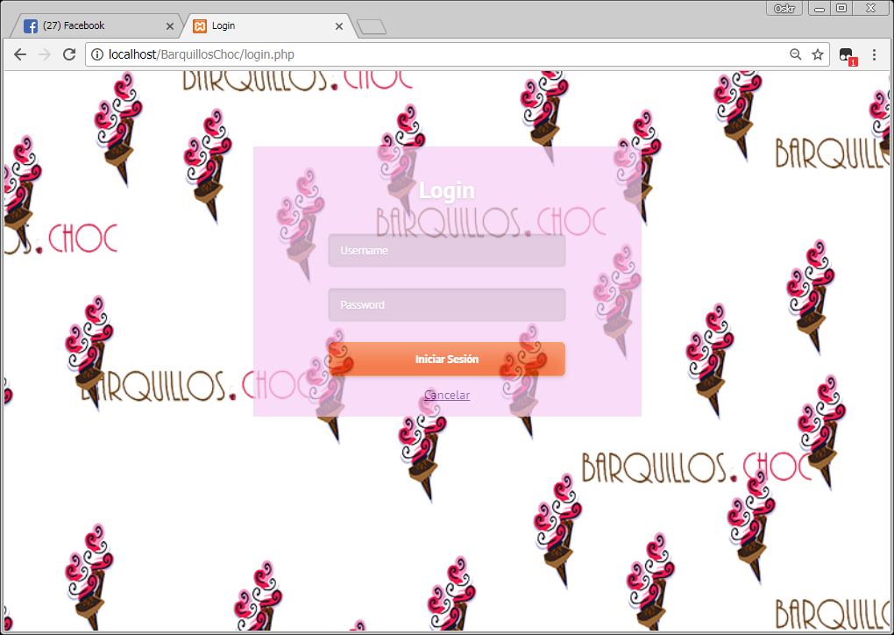
WEB SITE

Slide 5
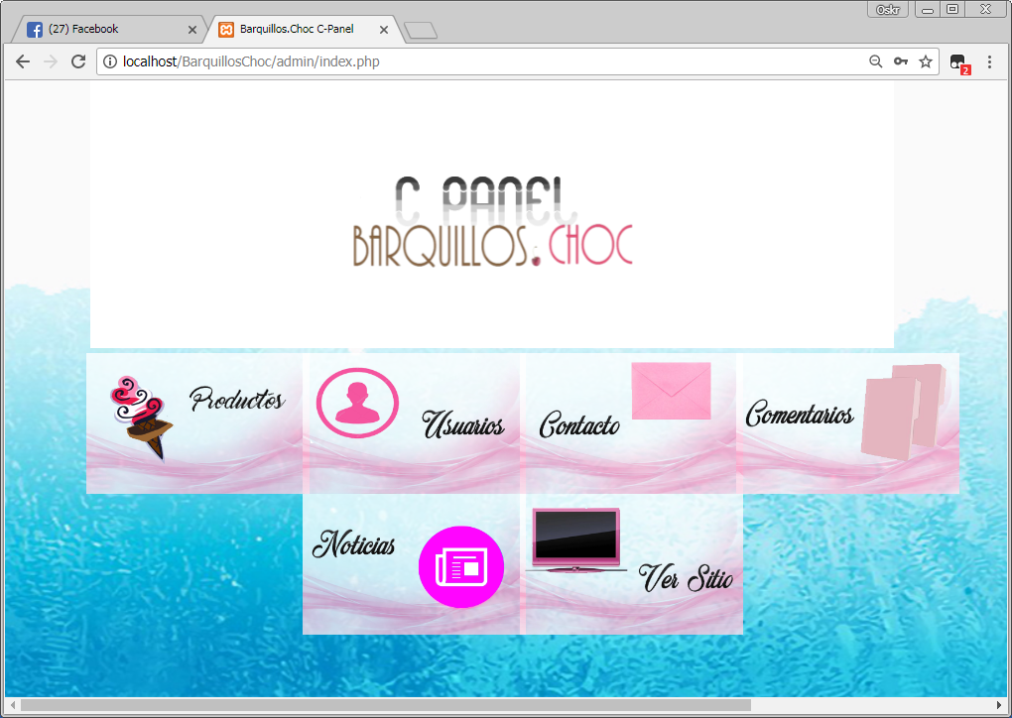
WEB SITE

Slide 6


Objectives…

Slide 7
Objective General
●
Develop an advertising website for the company "Barquillos Choc" of Acámbaro, Guanajuato, which began on February 02 and will end on April 13, 2018, with web tools such as the PHP web programming language and some frameworks design as can be bootstrap, among others. In order to provide a tool that favors its advertising methods.

Slide 8
Methodological Objective
●
● Plan activities for the construction of web management focused on the management of requirements and flows in project management.
● Carry out an investigation and compilation of the necessary material by means of data collection techniques for the construction of the web system.
● Analyze the information collected, to define the requirements and make the choice of the appropriate methodology for the planning and development of the project.

Slide 9
● Design the UML diagrams showing the interaction of the processes that will be carried out between the user and the system, with the necessary tools (StarUML, PHPMyAdmin).
● Make a sketch of the web system, to be able to define the navigation map and identify the components for the construction of the database, with the software Balsamiq Mockups and Corel Draw x7.
● Design the diagrams of the database.
● Encode the web system database in the MYSQL database management system.

Slide 10
● Coding the web system screens, which have been reviewed and validated, through the PHP web programming language.
● Perform tests on the web system carried out, before its implementation to identify eventual failures.
● Make a matrix with the changes that were established during the software tests.
● Make the necessary adjustments or changes to the system for its proper functioning.
● Implement the web system.

Slide 11

Scope…

Slide 12
To create an advertising website that allows our client to publicize their product visually and be interested in it, so that their market can increase their sales in a considered manner.
● To reach with the implementation of this advertising site, increase the public that knows about the product and therefore, the desire of more freeias to acquire this product

Slide 13
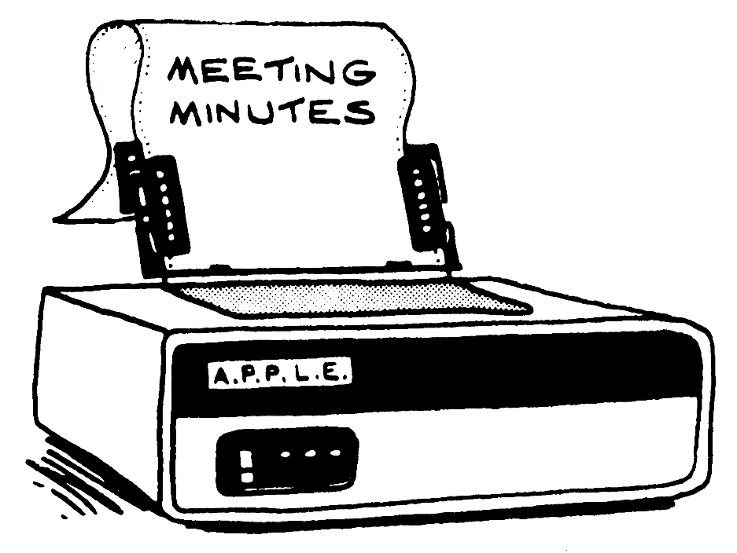
Minutes…

Slide 14

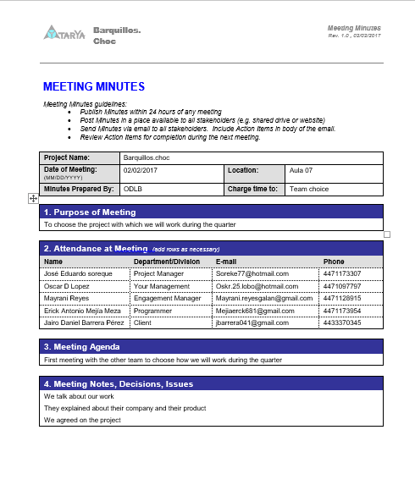
Meeting1_Minutes_Barquillos-Choc…

Slide 15

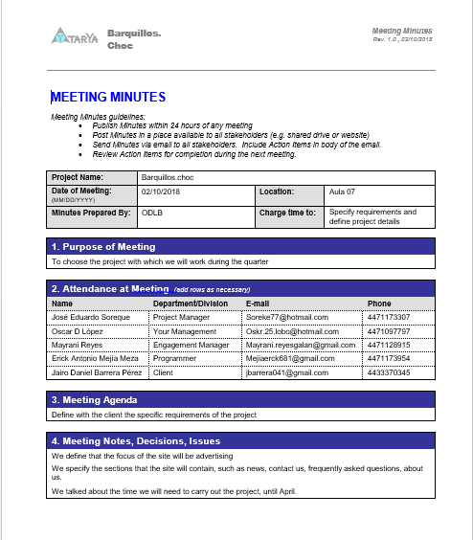
Meeting2_Minutes_Barquillos-Choc…

Slide 16
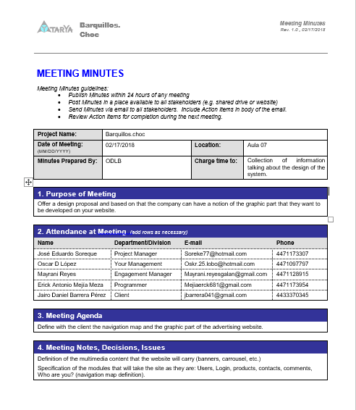
Meeting3_Minutes_Barquillos-Choc…

Slide 17
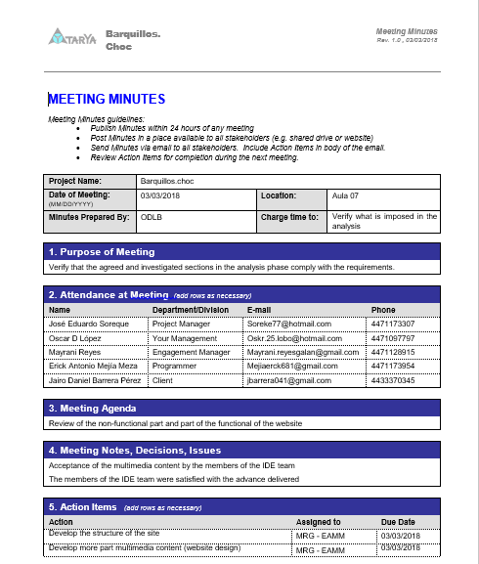
Meeting4_Minutes_Barquillos-Choc…

Slide 18
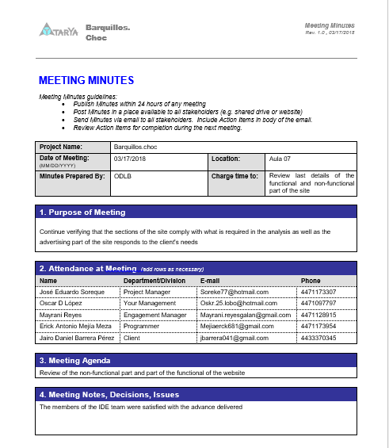
Meeting5_Minutes_Barquillos-Choc…

Slide 19
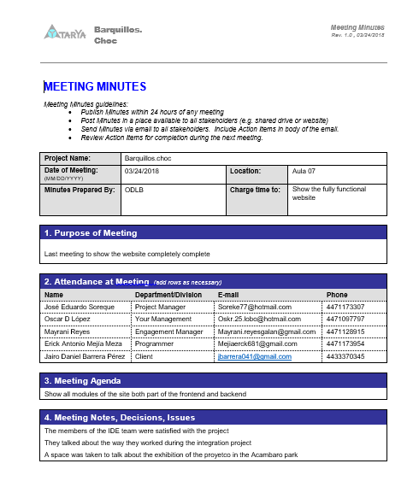
Meeting6_Minutes_Barquillos-Choc…

Slide 20

Deliverables…

Slide 21

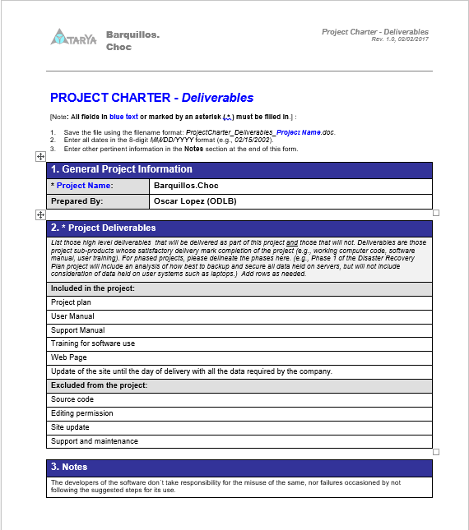
Project_Charter_Deliverables_Barquillos-Choc

Slide 22
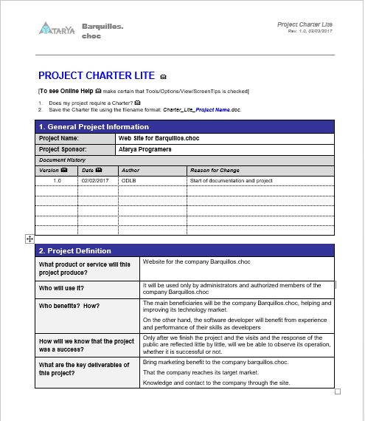
Project_Charter_Lite_Barquillos-choc

Slide 23
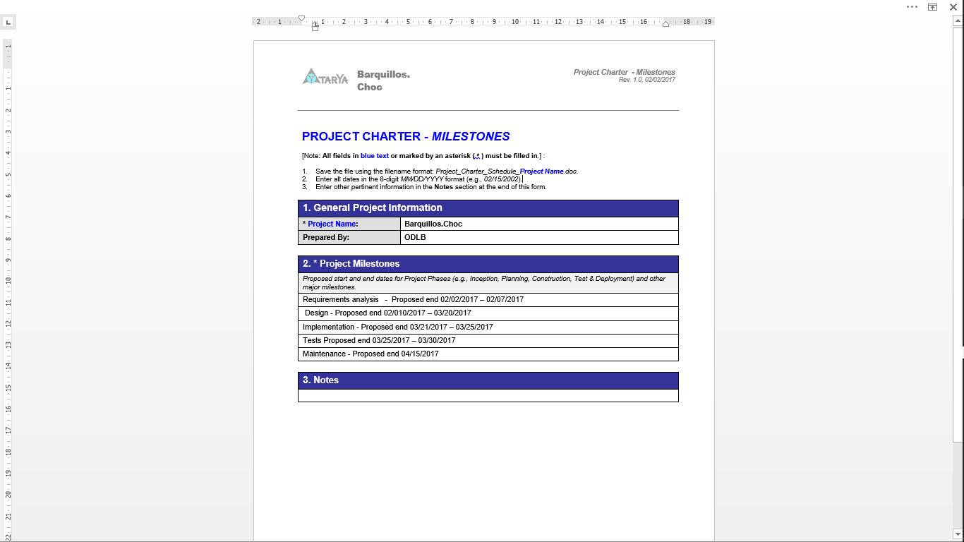
Project_Charter_Milestones_Barquillos-Choc

Slide 24

Study of roles…

Slide 25

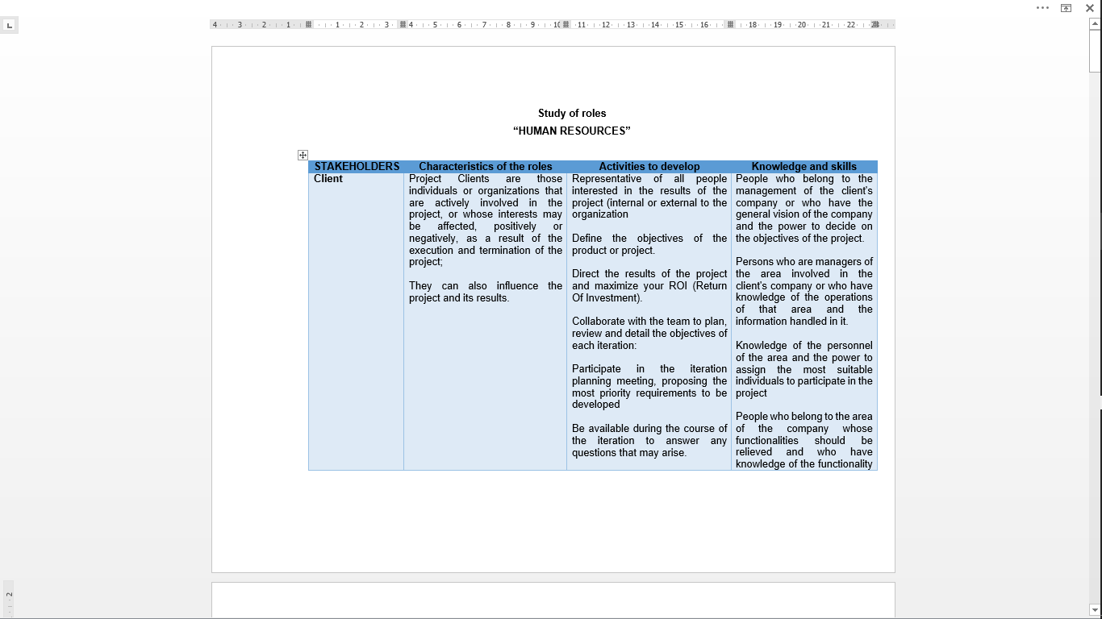
Study of roles

Slide 26

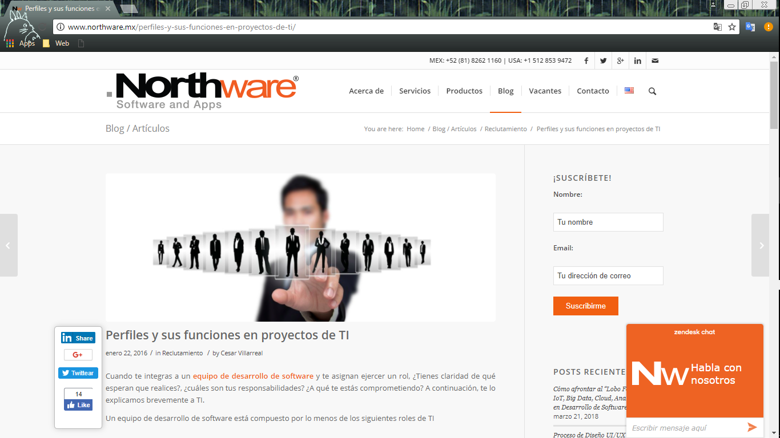
Study of roles
Base website
http://www.northware.mx/perfiles-y-sus-funciones-en-proyectos-de-ti/

Slide 27
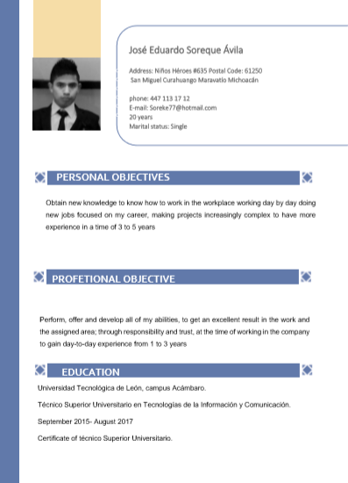
Curriculum vitae resume
José Eduardo Soreque Ávila

Slide 28
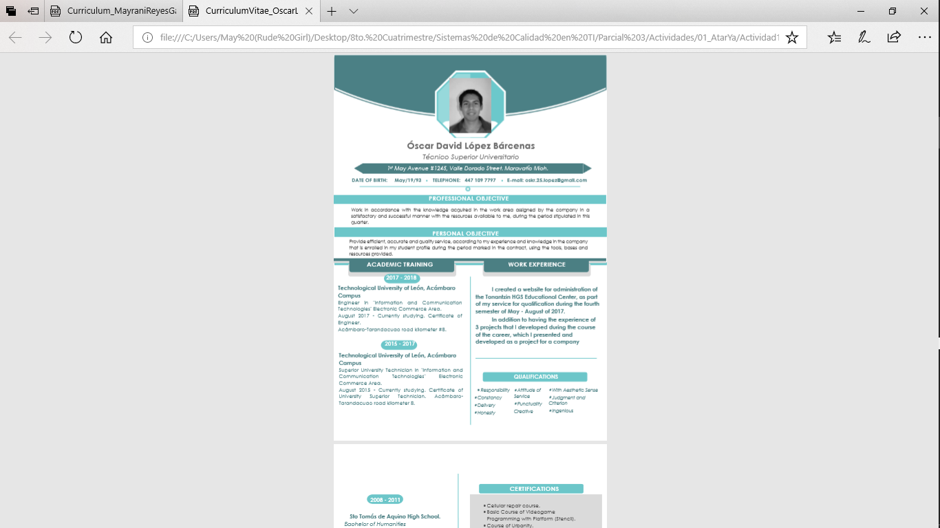
Curriculum vitae resume
Oscar David López Bárcenas

Slide 29
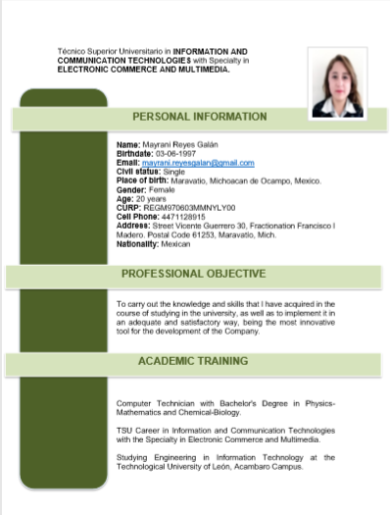
Curriculum vitae resume
Mayrani Reyes Galán

Slide 30
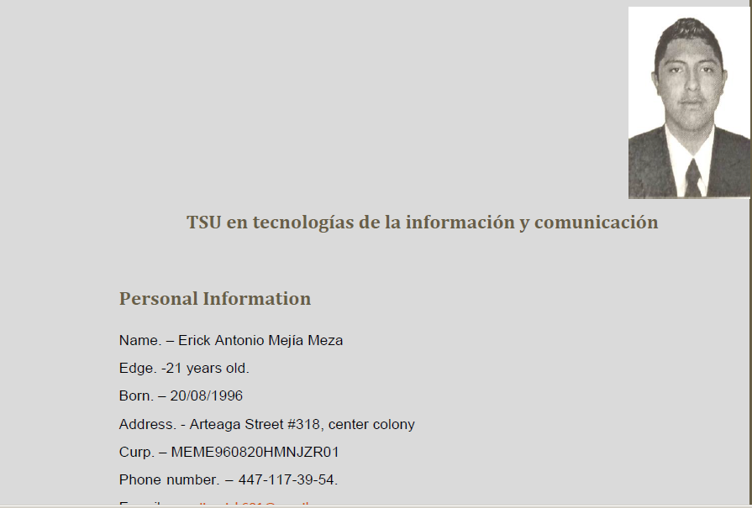
Curriculum vitae resume
Erick Antonio Mejía Meza

Slide 31

Life Cycle Plan…

Slide 32
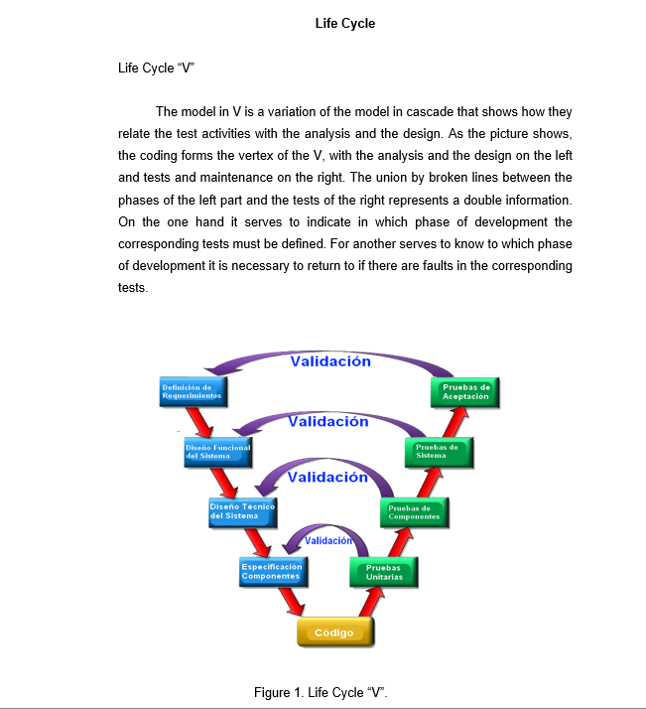


Slide 33
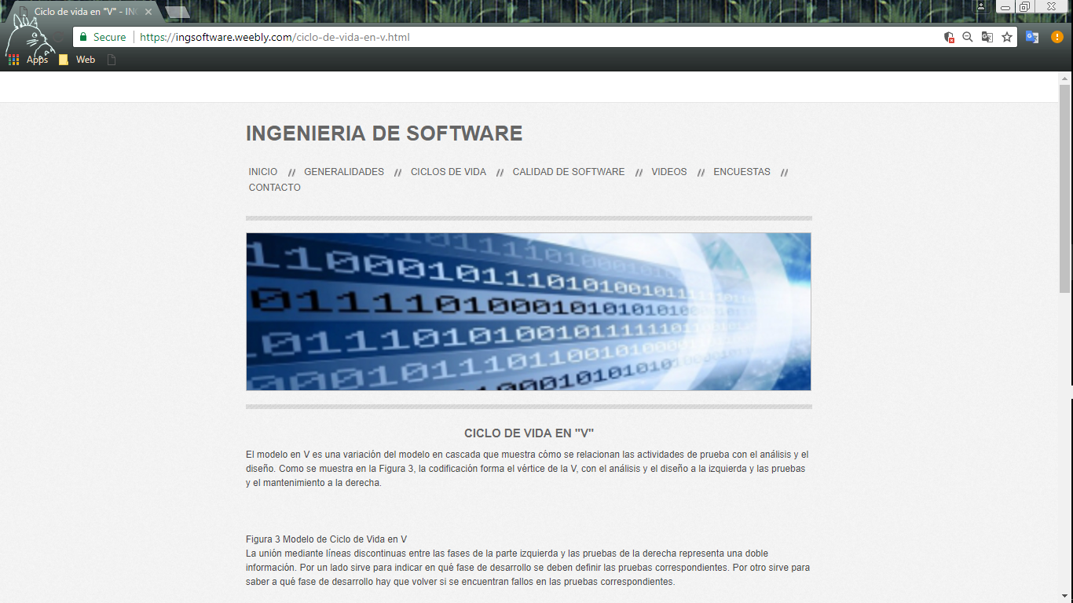
Base website
https://ingsoftware.weebly.com/ciclo-de-vida-en-v.html

Slide 34
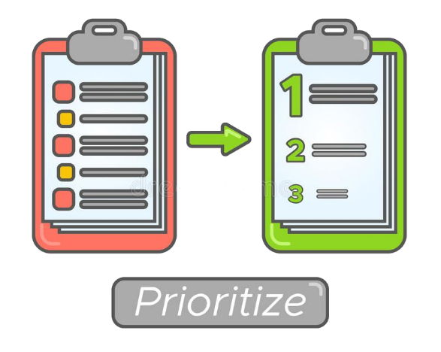
Priorities in the project…

Slide 35

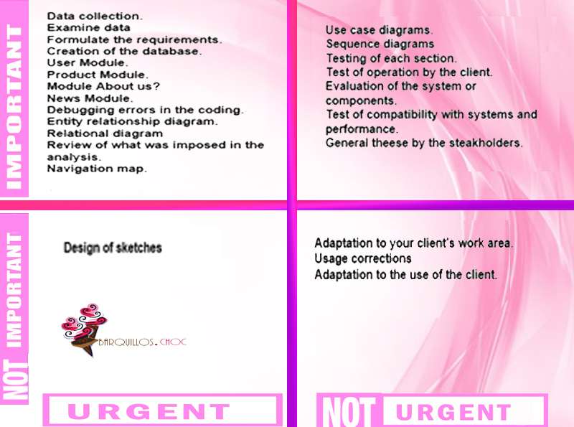

Slide 36

Quality tool for project management of T.I.

Slide 37

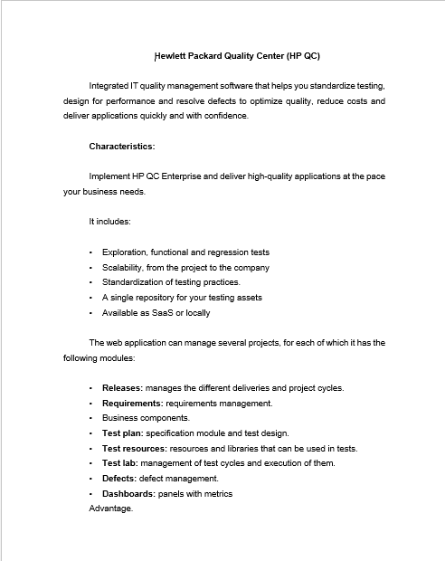
Hewlett Packard Quality Center…

Slide 38
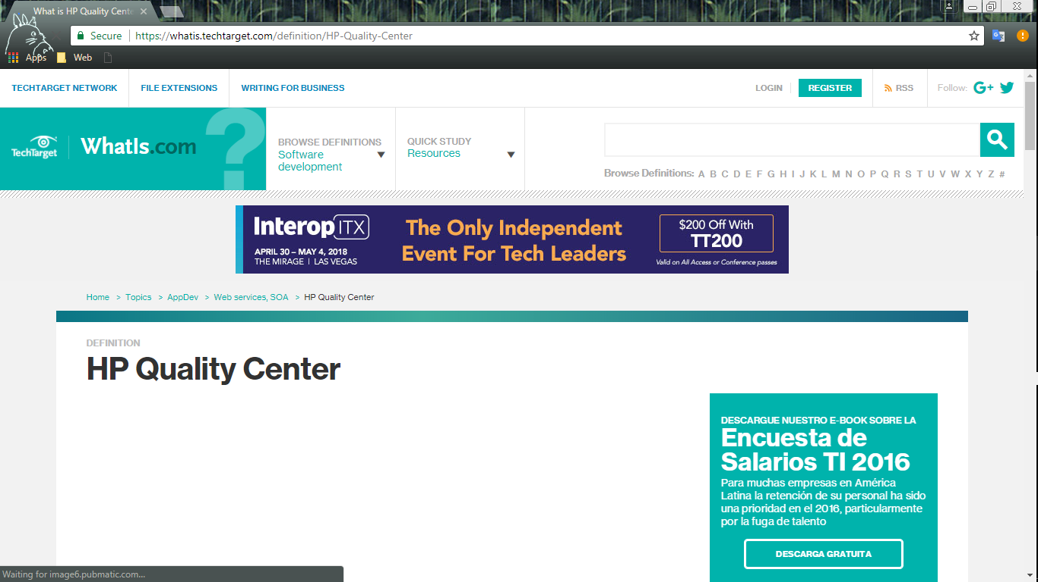
Base website…
https://whatis.techtarget.com/definition/HP-Quality-Center

Slide 39
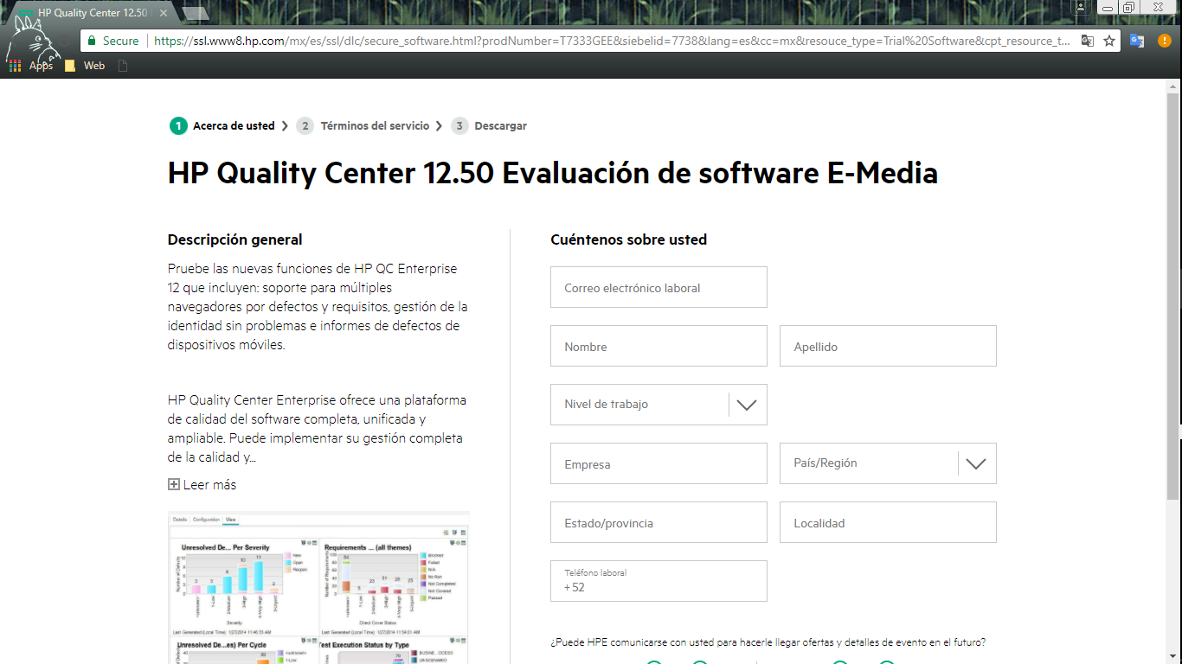
Base website…
https://ssl.www8.hp.com/mx/es/ssl/dlc/secure_software.html?prodNumber=T7333GEE&siebelid=7738&lang=es&cc=mx&resouce_type=Trial%20Software&cpt_resource_type=hp.resource_type.software_trial.label&sectionid=software&subbu=TSG.Software&simpletitle=try%20now%2Ffunctional%20testing&parentUrl=https%3A%2F%2Fwww.google.com%2F

Slide 40
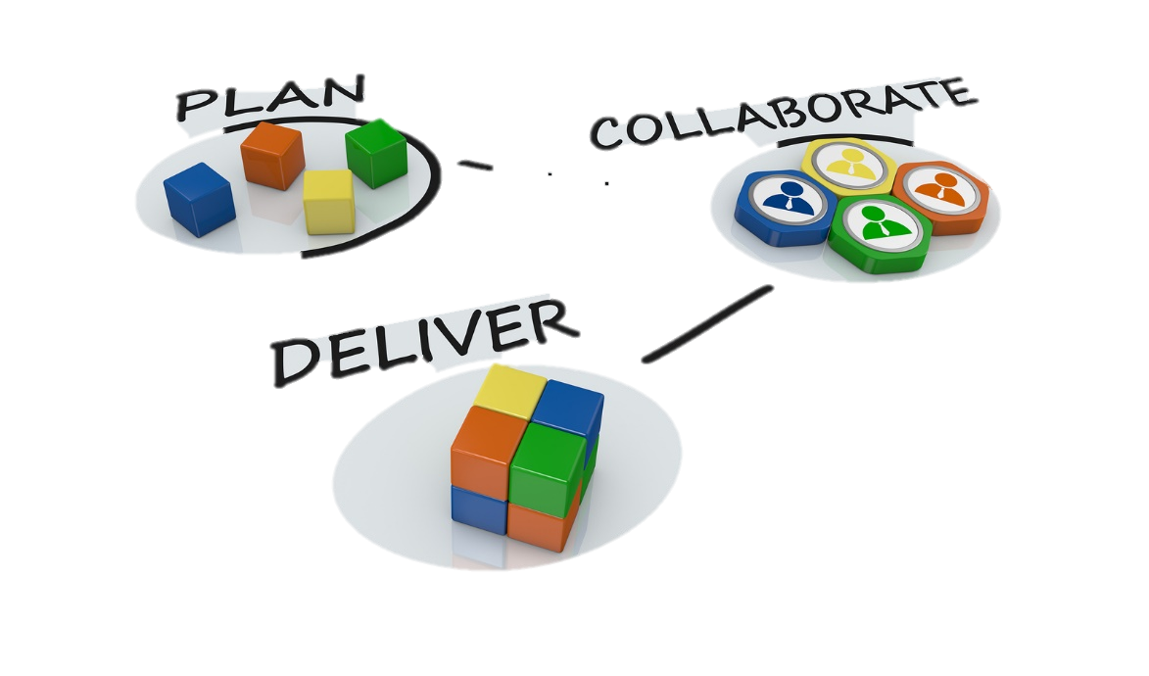

Project…

Slide 41
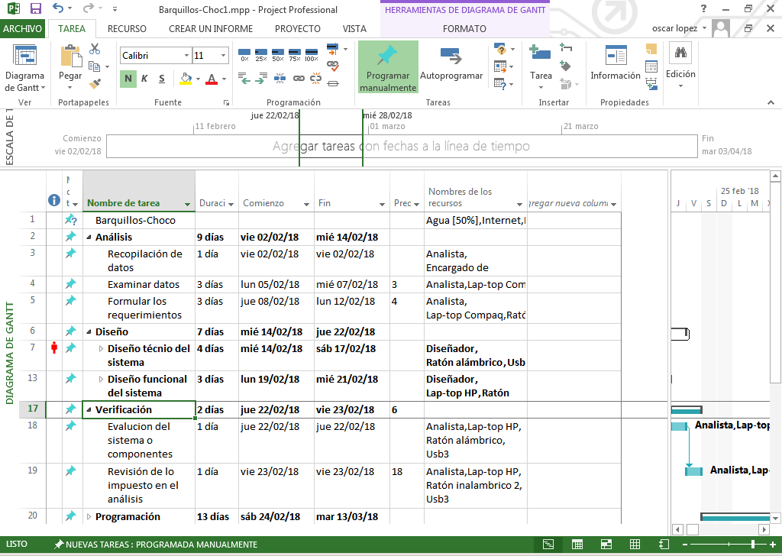
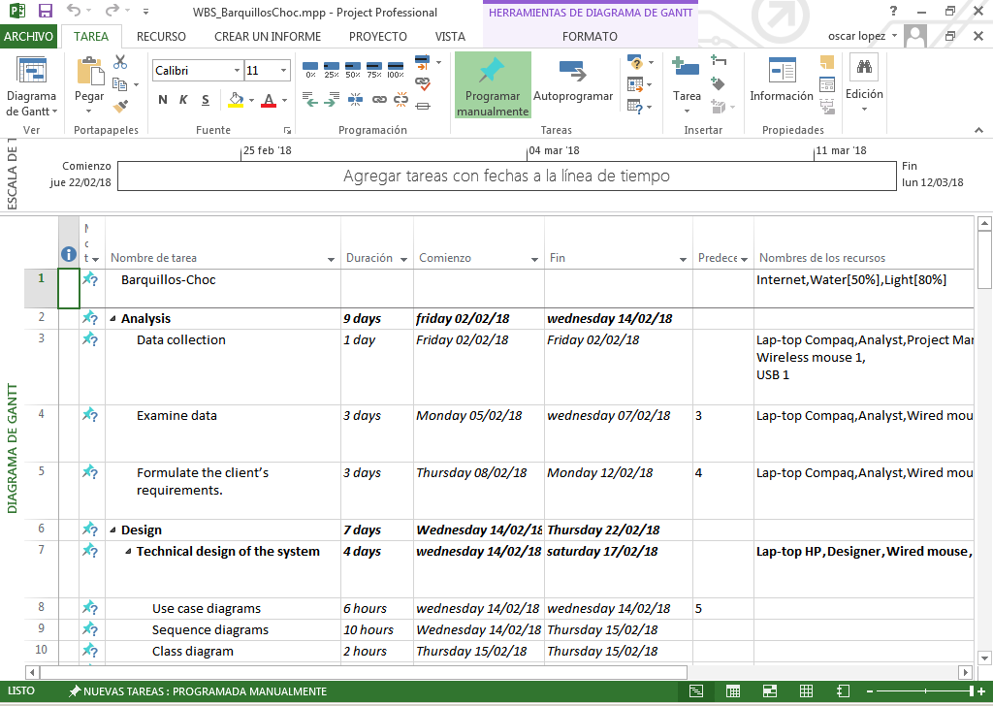
Project

Slide 42
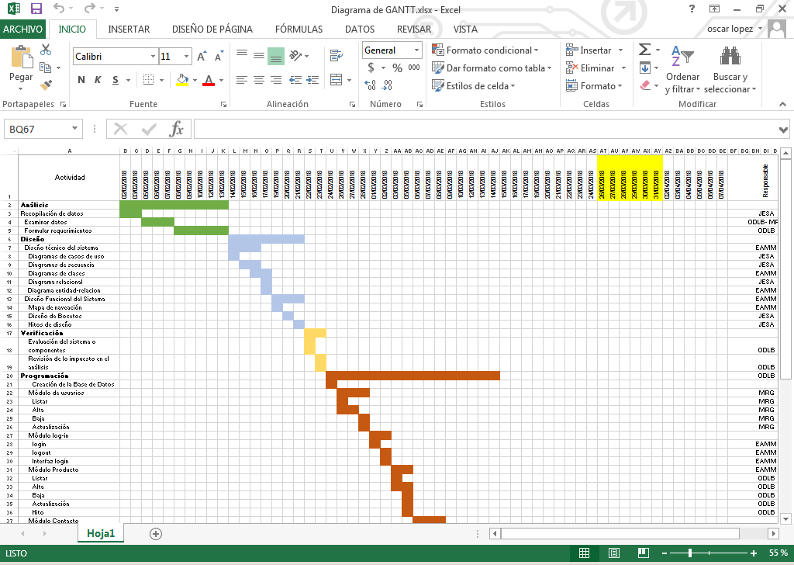
Gantt

Slide 43
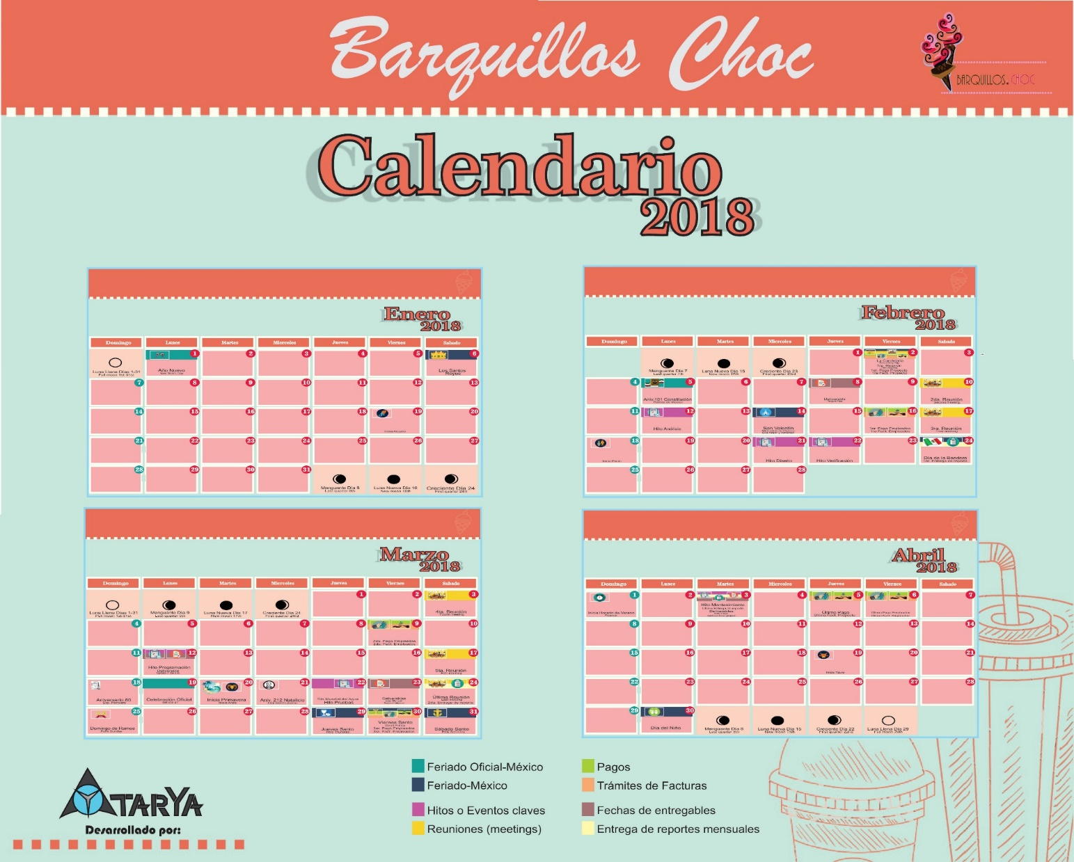
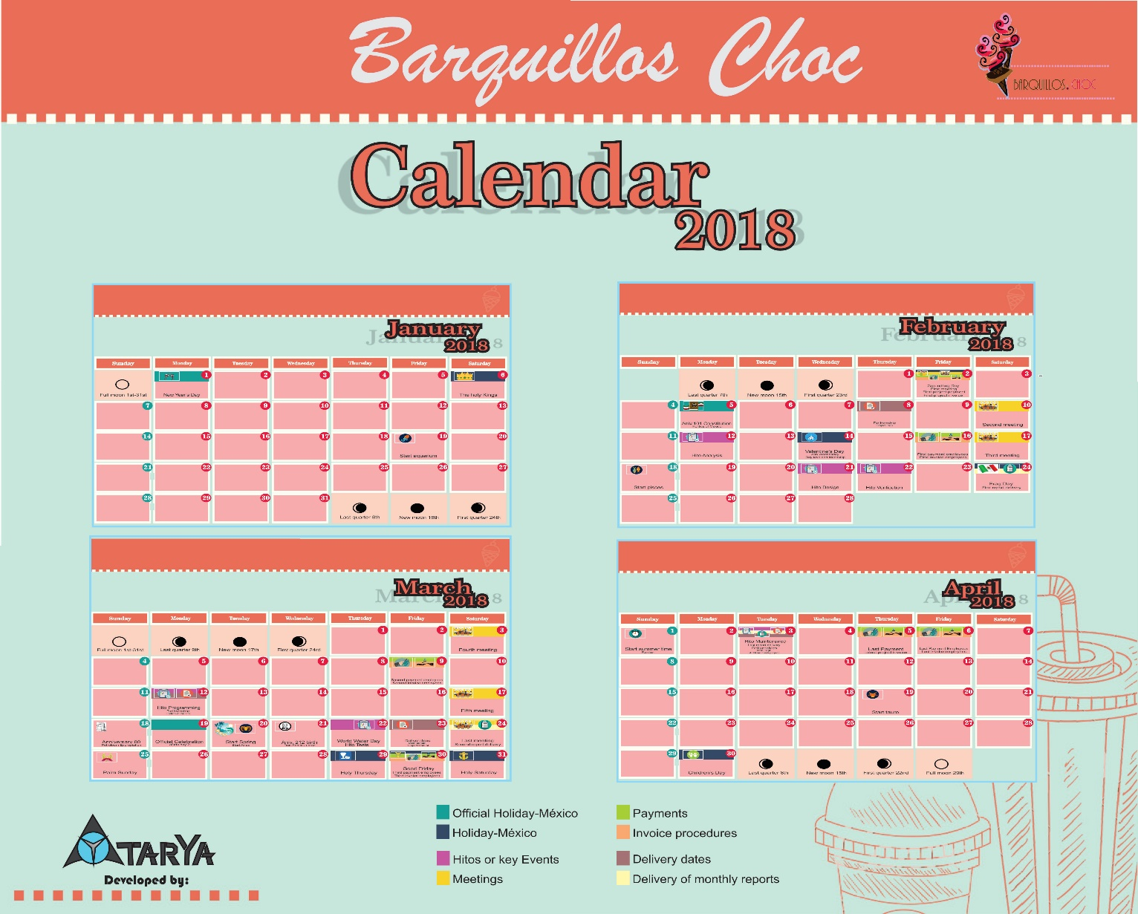
Activities Calendar

Slide 44
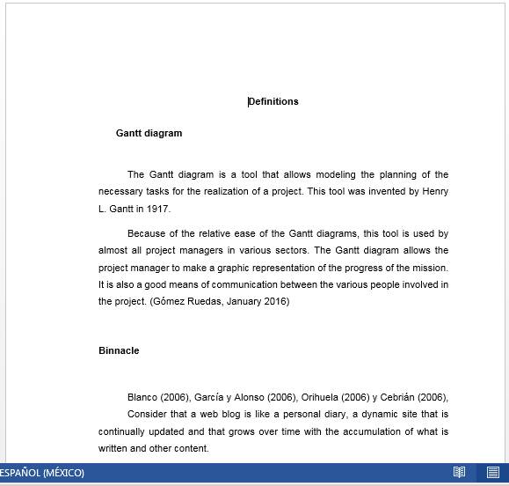
Definitions

Slide 45
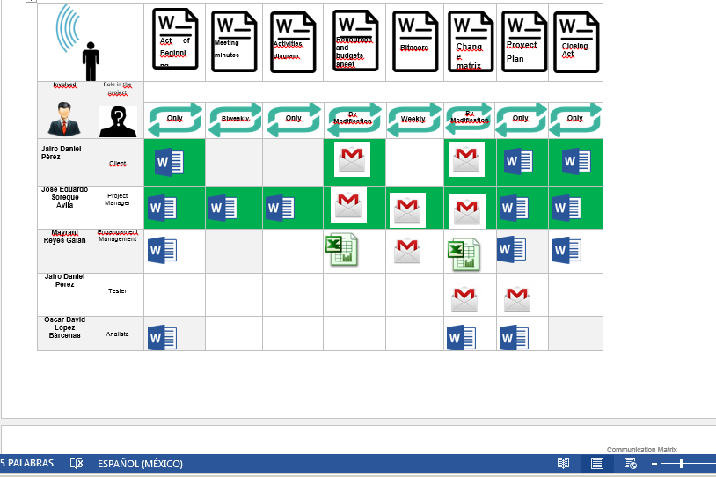
Comunication Matrix

Slide 46


Resources…

Slide 47
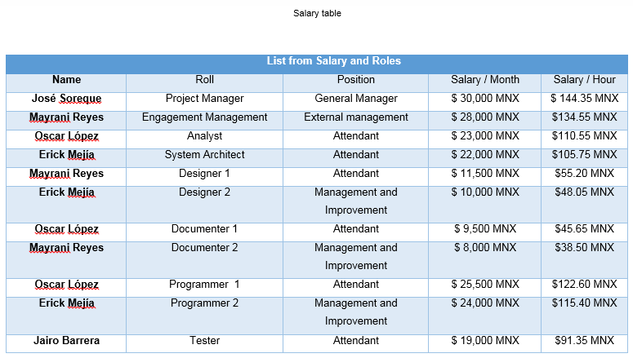
Resources Management

Slide 48
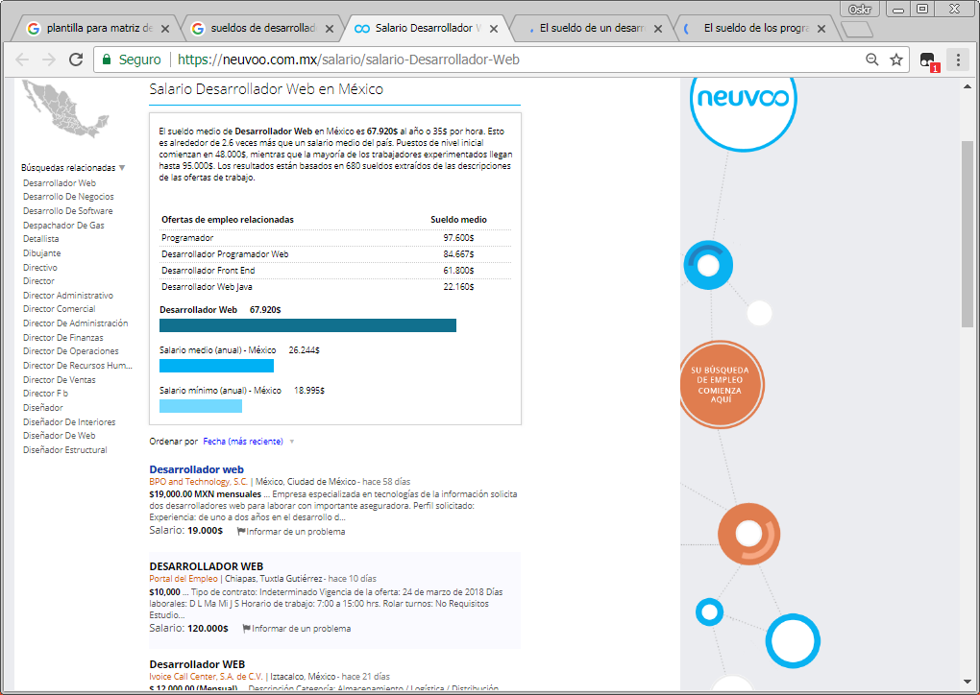
Resources Management
https://neuvoo.com.mx/salario/salario-Desarrollador-Web
https://computerhoy.com/noticias/software/sueldo-programadores-descubierto-31147

Slide 49
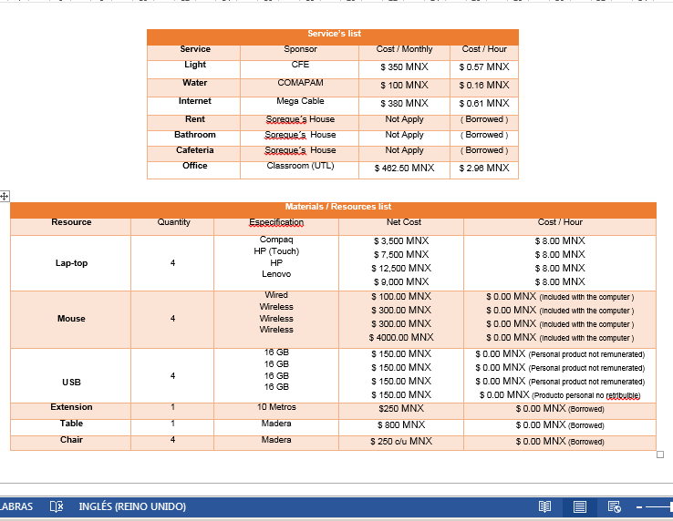
Resources Management
http://bibliodigitalibd.senado.gob.mx/bitstream/handle/123456789/1709/Tarifas_Electricas.pdf?sequence=1&isAllowed=y

Slide 50
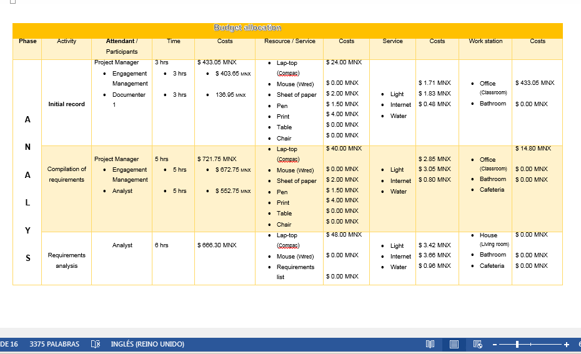
Resources Management
https://neuvoo.com.mx/salario/salario-Desarrollador-Web
https://computerhoy.com/noticias/software/sueldo-programadores-descubierto-31147

Slide 51
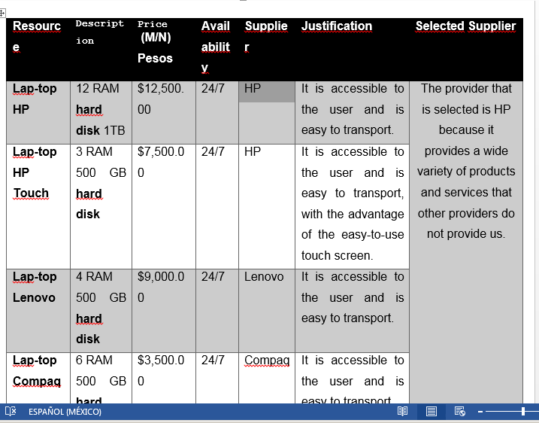
SUPLIERS
https://buzzvizz.com/mejores-marcas-de-portatiles/
https://portatiles-baratos.net/comparativa/

Slide 52
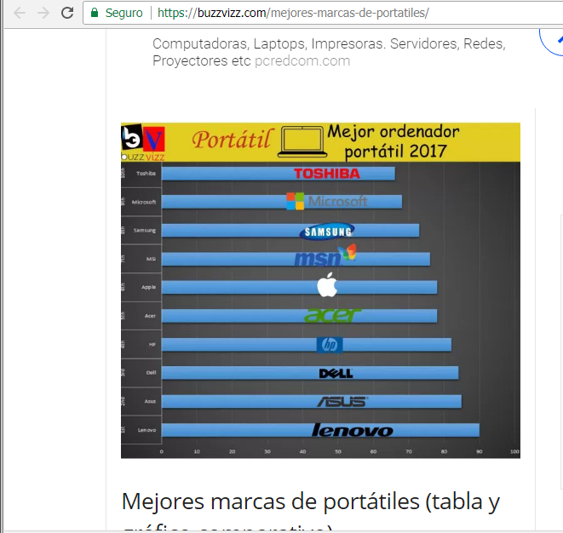
SUPLIERS
https://buzzvizz.com/mejores-marcas-de-portatiles/
https://portatiles-baratos.net/comparativa/

